Slide 1

Session 3.1
Selenium WebDriver –
Finding Elements

Slide 2
Topics
Covered
Finding Element(s) in WebDriver

Slide 3
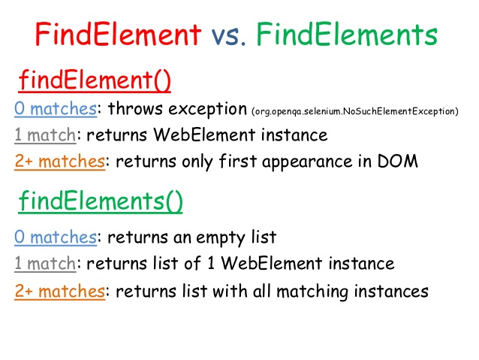
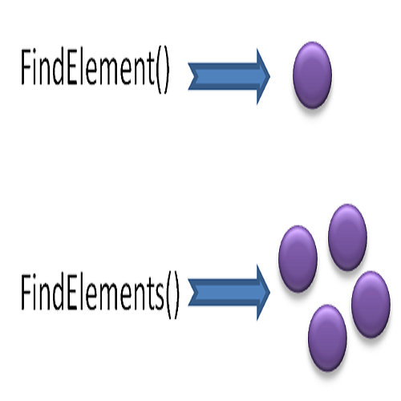
Finding Element(s)
in WebDriver

Slide 4
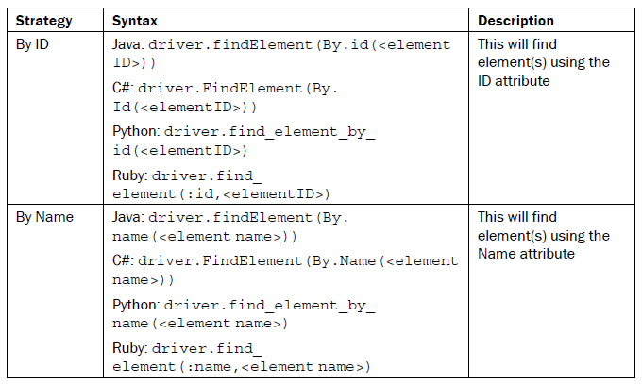
Finding Element(s)
in WebDriver

Slide 5
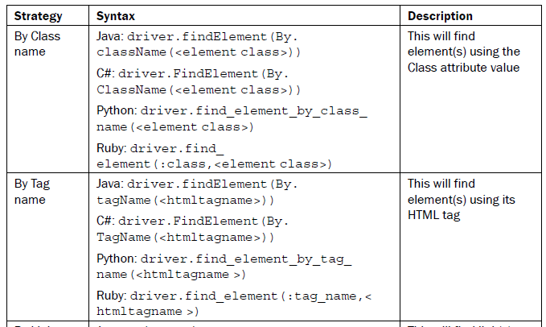
Finding Element(s)
in WebDriver

Slide 6
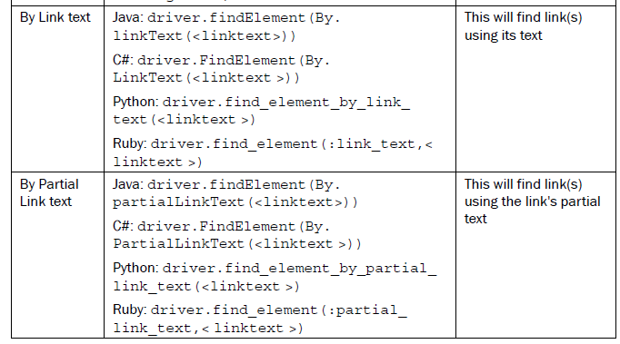
Finding Element(s)
in WebDriver

Slide 7
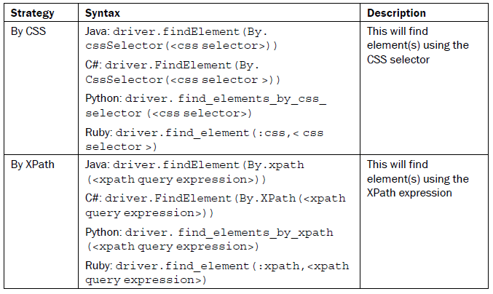
Finding Element(s)
in WebDriver

Slide 8


Slide 9
Knowledge Check
What are different ways to work with elements in WebDriver?

Slide 10

Thank you!

